Slide 1
Managed Print Services
4CIO Club
Евгений Моржевилов

Slide 2
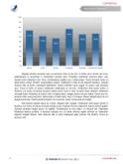
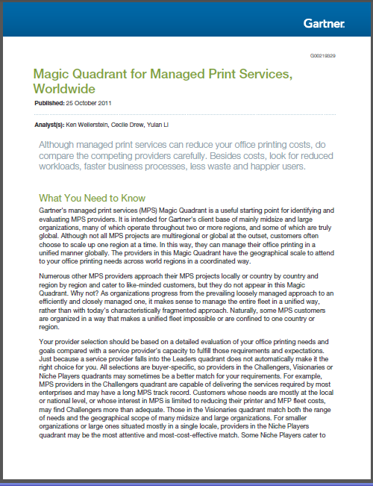
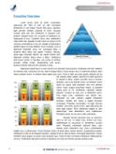
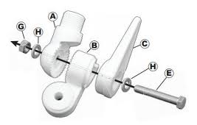
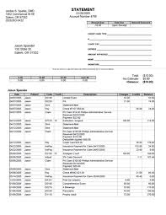
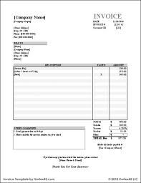
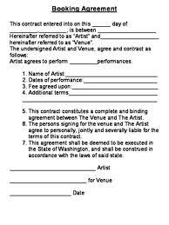
Роль документа в офисе
3 задачи документа
Поддержка продаж
Продажи
Помощь бизнесу в увеличении продаж
Notes:
Try and customise this to every client
They are what you sell: reports, books, analysis, accounts, contract for services
They support what you sell: brochures, user guides & manuals,
They support your business to sell: invoices, statements, product descriptions, appointment letters, marketing mailings, general business correspondence

Slide 3
Сколько стоит офисная печать?
Видимые затраты
ИТ поддержка и инфраструктура
Закупки и администрирование
Печать (рабочее время сотрудника).
Делопроизводство
These figures are for guidance purposes only. This analysis is predictive in nature and is intended for discussion purposes only. Data copyright© 2012 ALL Associates Group, Inc.
Notes:
Right click on the chart above and select Edit Data…
Select the industry from the drop down list – if not there simple use the average
In Cell C8 please insert the number of employees the firm has
Cell C4 should not be changed, but if you have actual annual turnover / revenue please insert it in C5
Check that the numbers match the data in the spread sheet, and if necessary right click on the labels above and then Format Data Labels > then Reset Label Text if it does not match. As a last check put the text back into the right colour (white).

Slide 4
Сколько стоит офисная печать?
Видимые затраты
ИТ поддержка и инфраструктура
Закупки и администрирование
Печать (рабочее время сотрудника).
Делопроизводство
These figures are for guidance purposes only. This analysis is predictive in nature and is intended for discussion purposes only. Data copyright© 2012 ALL Associates Group, Inc.
Notes:
Right click on the chart above and select Edit Data…
Select the industry from the drop down list – if not there simple use the average
In Cell C8 please insert the number of employees the firm has
Cell C4 should not be changed, but if you have actual annual turnover / revenue please insert it in C5
Check that the numbers match the data in the spread sheet, and if necessary right click on the labels above and then Format Data Labels > then Reset Label Text if it does not match. As a last check put the text back into the right colour (white).

Slide 5
Выгоды MPS
Фокус на снижении издержек
Оптимизация за счет использования технологических решений вендора
Соответствие бюджету согласно контракту
Печатный парк
Фиксированные издержки
Инструменты управления (ПО)
Оптимизация
Профессиональные услуги
Переменные издержки, компенсируются по мере потребления
Поддержка и отпечаток

Slide 6
Переход на MPS
Масштабирование
Снижение интереса к проекту после запуска
Внимание к отчетности

Slide 7
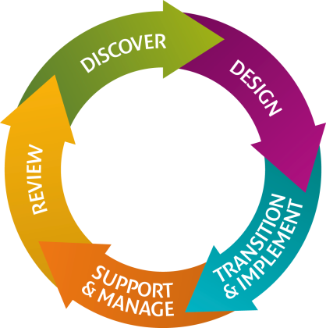
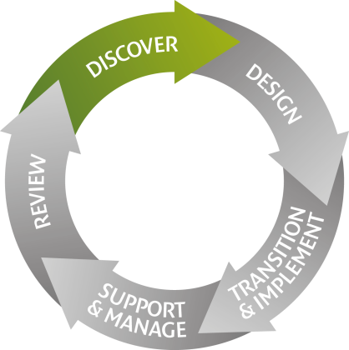
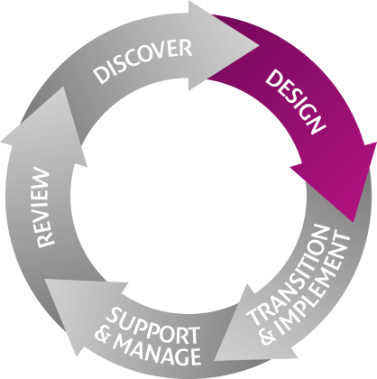
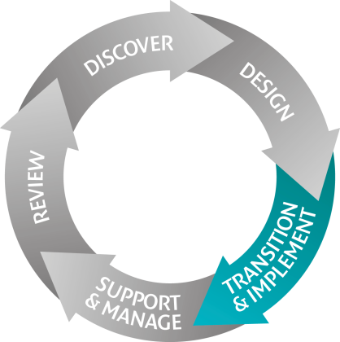
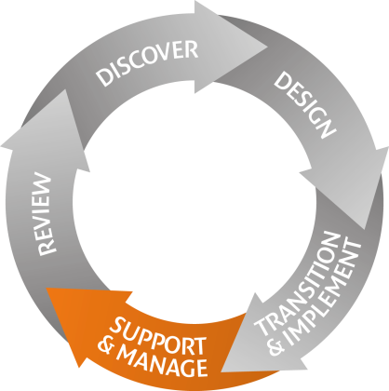
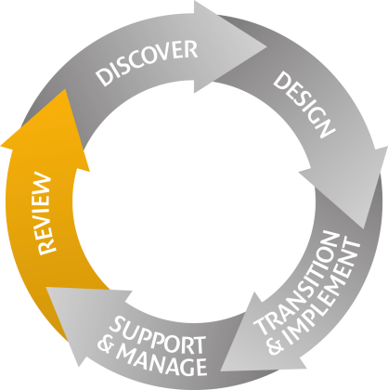
Подход
5-ступенчатый подход на основе ITIL®
Прямые и партнёрские контракты
Услуги и современные инструменты управления
Notes:
Think of ITIL as a

Slide 8
Аудит
Печатные объемы
Состояние парка
Размещение оборудования
Пользовательские задачи.
Notes:
This combines physical network scans connected to your network with a web-based end-user survey, with the resulting report identifying areas of potential waste which could be minimised - alongside a suggested solution to optimise your infrastructure and recommendations for the future.

Slide 9
Спасибо за внимание – вопросы?
Notes:
Cost control - as we will be providing visibility of what is being printed where, how and by whom, we can manage and change behaviours for you. Helping you to reduce costs and prevent them spiralling out of control again.
Effective integration - MPS Essentials fits neatly into the way you currently do business and will improve the way document communication works. Importantly, there are no complex IT requirements either as integration is straightforward.
Increased productivity - there will be no more searching for output or reprinting jobs if a device is down. And you won’t have devices sitting idle because nobody ordered toner. Plus, it won’t be your staff wandering around, checking meter readings and trying to understand how to help everyone print more effectively.
Enhanced document security - you can collect confidential prints at devices when you are ready, instead of dashing to collect them as soon as they’re sent.
Improved sustainability - your streamlined infrastructure should consume less power and result in fewer pages output. And since Canon cares about the environment, rest assured that we’ve minimised device impact at every stage of its lifecycle. We have icons for these 5 areas now (Chaos created) that we could use in the brochure rather than simple bullets.
And though we can deliver this value across your print infrastructure we can leverage our capability to address the end to end document environment

